Slide 1

Project GROW
Predictive self-sustaining irrigation system
Project Report until 26/04/21

Slide 2
TEAM MEMBERS:
Preity M
Roll No: 108118074
Dept: ECE
Rohit S
Roll No: 111118103
Dept: MECH
Vaisnav A
Roll No: 108118105
Dept: ECE
Vaibhav A
Roll No: 110118094
Dept: ICE

Slide 3
Introduction:
The scarcity of clean water resources around the globe has generated a need for their optimum utilization.
The main objective of this project is to provide an automated irrigation system to minimize the utilization of water in agriculture by combining technologies like Internet of Things (IoT), optimization tools and cloud computing.
Our aim is to design a modest, easy to install methodology to monitor and indicate the soil moisture level and using weather prediction, that is regularly organized and automated.
Actuation technology has played an essential role in the water industry in a wide range of areas.
In this project, the actuator we're using is a solenoid valve, which is an ON/OFF position actuator.
The control algorithm for the input of actuator will be optimised for maintaining good health of the plants and also helps in the conservation of resources.

Slide 4
Motivation for choosing this project:
In India, where 60-70% economy depends on agriculture, there is a great need to modernize conventional agricultural practices for better productivity.
The scarcity of clean water resources around the globe has generated a need for their optimum utilization.
IoT based smart irrigation systems can help in achieving optimum water-resource utilization in the precision farming landscape.
Irrigation done using canal systems affects crop health and produces a poor yield because some crops are too sensitive to water content in soil.
Another major issue is over-watering of plants. This issue is also addressed by monitoring the soil.
For effective and optimum utilization of fresh water in irrigation, it becomes essential to develop smart irrigation systems based on dynamic prediction of soil moisture pattern of the field and precipitation information of upcoming days.

Slide 5
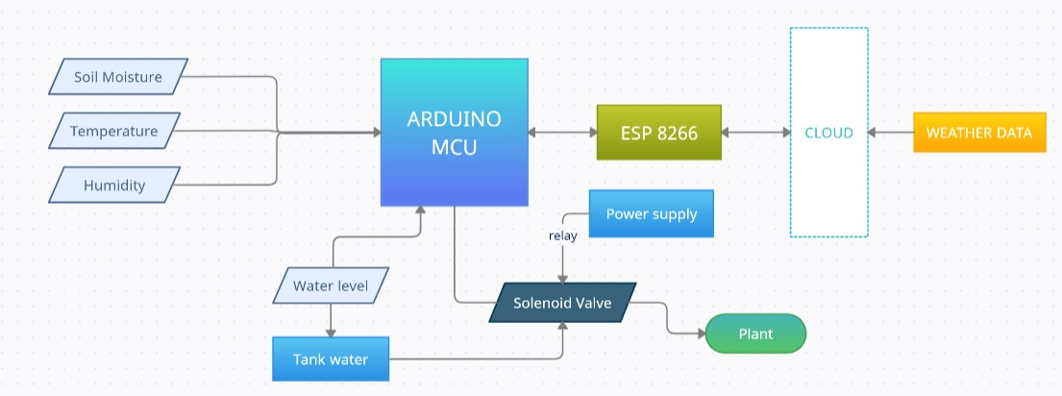
Block Diagram:

Slide 6
Problem we’re trying to address:
One of the common factor that is not accounted in most of the cases when it comes to smart irrigation is the water level in tank is generally not accounted – water flow rate is dependent on water level in tank.
It is generally advised that we not water the plants at high temperature.
Therefore, we have tried to reduce this cost by using a different watering method that has high out-flow but for a lesser amount of time – this can be calibrated uniquely to different variety of crops.
In the algorithm that we developed for valve closing and opening of valve, these different features are incorporated (not optimized) and an output is derived.

Slide 7
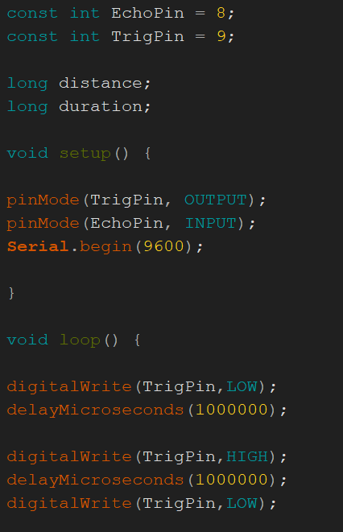
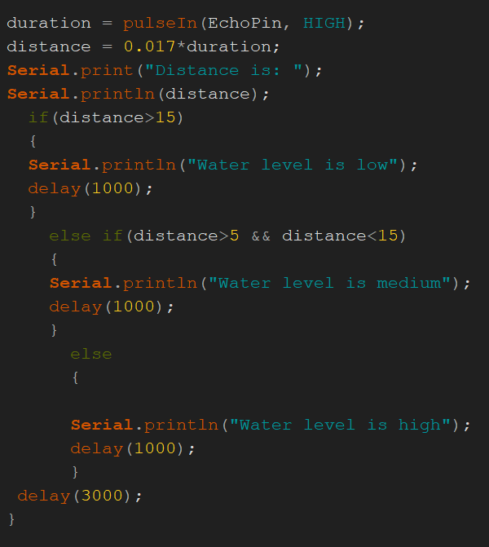
Ultrasonic Sensor - Module Code

Slide 8
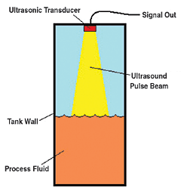
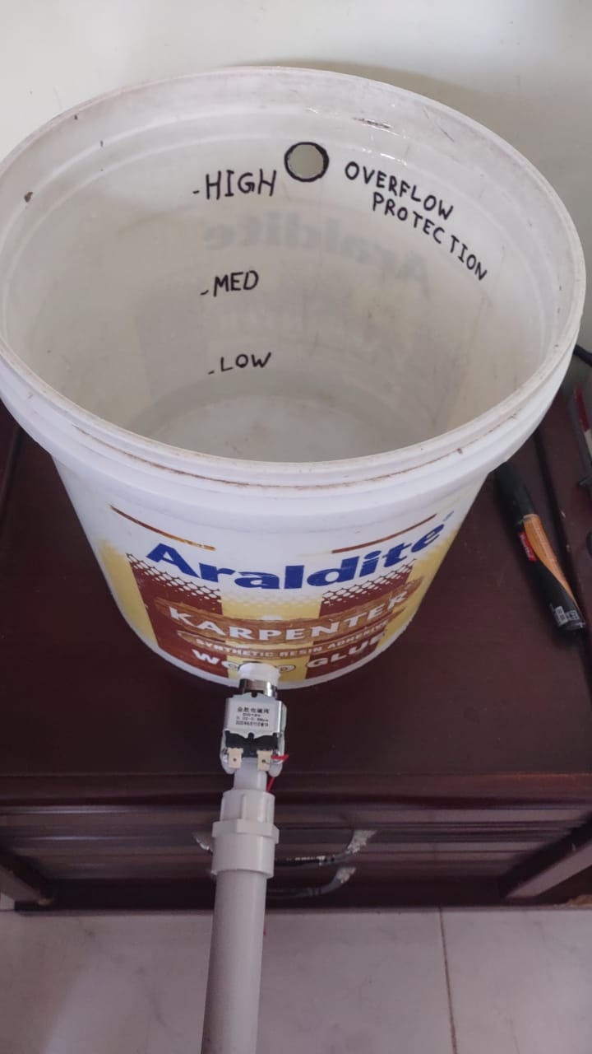
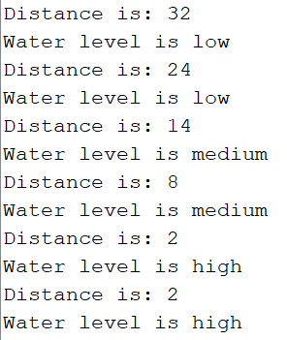




Ultrasonic Sensor - Code Functionality
Function:
Measures the water level in the tank
Gives three water level indications
(i) Low
(ii) Medium
(iii) High

Slide 9
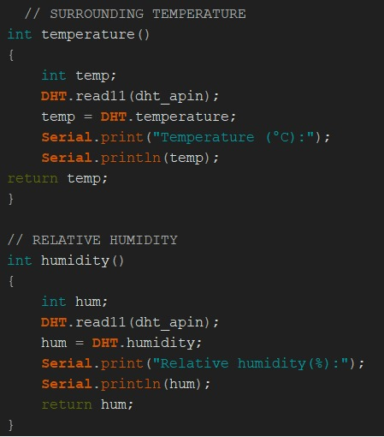
DHT11 Sensor - Module Code

Slide 10
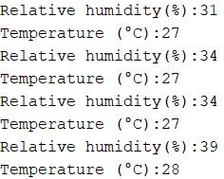
DHT11 Sensor - Code Functionality
Function:
Measures the temperature and relative humidity in the surroundings.
The obtained data can be used to set the threshold values to actuate the solenoid valve.

Slide 11
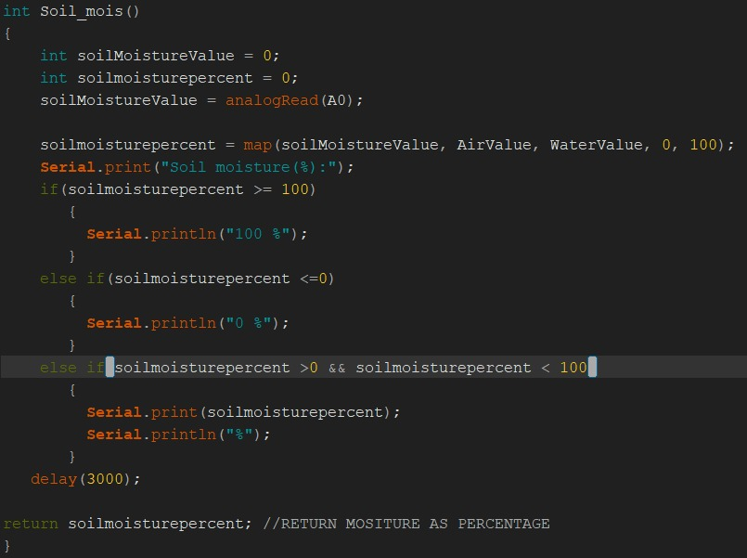
Capacitive Soil Moisture Sensor - Module Code

Slide 12
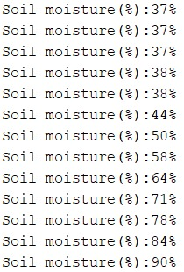
Capacitive Soil Moisture Sensor - Code Functionality
Function:
The sensor collects the soil moisture level.
The example on the right shows the change in the moisture level after the addition of water to the soil.

Slide 13
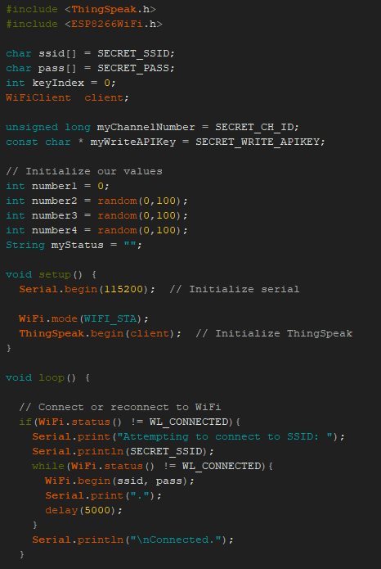
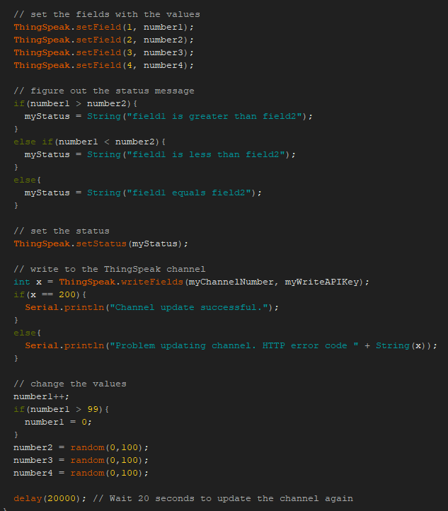
Sending Data to Thingspeak through ESP8266 - Module Code

Slide 14
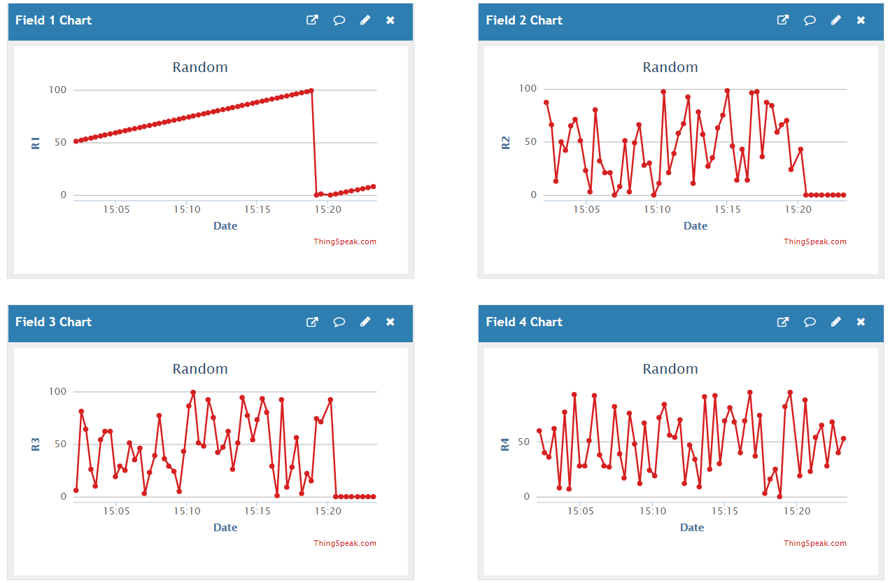
Sending Data to Thingspeak through ESP8266 - Code Functionality
Function:
Data obtained from the sensors is sent to the Thingspeak cloud and can be easily tracked remotely.
The example on the right shows random values being updated to the Thingspeak cloud.

Slide 15
Actuation of Solenoid value using relay
Temperature (Low- up to 30 deg) | Soil Moisture (Dry/Wet) | Water level(in tank) [Low-No water sent] | ON Time (in seconds) [roughly estimated]
LOW | LOW | MEDIUM | 6
LOW | LOW | HIGH | 4
LOW | HIGH | MEDIUM | 0
LOW | HIGH | HIGH | 0
HIGH | LOW | MEDIUM | 5
HIGH | LOW | HIGH | 3
HIGH | HIGH | MEDIUM | 0
HIGH | HIGH | HIGH | 0
The solenoid value will be operational based on the parameters set.
When the threshold values are crossed, the valve will be open for a certain time period depending on the current data values.
The tabular column on the right gives the ON TIME for different cases possible.

Slide 16
Issues faced and solution: Hardware:
1. Finding a proper coupler to attach the solenoid valve to the water tank(here, drum)
Sol: Using a stainless-steel pipe coupling along with Teflon tape and M-Seal to prevent leaks
2. Not enough power to drive all sensors(consumes in order of mW)
Sol: We generally use 5V from Arduino - better to power externally using Lithium-ion battery with Lipo tester (rechargeable)
3. Constant and stable 3.3V supply to ESP8266
Sol: Using 3.3V from Arduino might damage the module - use a 3.3V regulator and step down.
4. Damage of ESP8266 due to TX of Arduino (5V transmission can fry the ESP8266)
Sol: Use a voltage divider circuit to reduce to 3.3 (2.2kohm and 1k ohm)
5. Loose wire connection in Breadboard
Sol: Always test connections using a multimeter
TIP: Use capacitors in power voltage regulator supply to filter only DC voltage

Slide 17
Issues faced and solution: Software:
1. Firmware not updated in ESP8266 Wi-Fi module
Sol: Use either Arduino or USB to TTL converter (with ESP8266 in flash mode) and update it.
2. USB drivers for Arduino - not working
Sol: Install CH340 driver (TTL - USB converter)
3. USB COM Port not detected?
Sol: Try changing the COM port or the data cable itself
4. Messy code?
Sol: Use function modules and integrate.

Slide 18
Mobile App:
We’ll be creating a mobile app for the real time monitoring of the sensed input.
Communication will occur between the application created and thingspeak(MATLAB) via the Thingspeak API.
The user will be able to get weather forecast in the app, along with moisture levels of soil, and the desired water level.
Also the user will get a notification if rains are predicted the next day.
Also the user will get a notification from the app to irrigate/water the plant if the level of water is lesser than the desired levels.

Slide 19
Bill of Materials:
 | COMPONENT | COST | WEBSITE
Robu | Jumper wire set | 75 | Buy Male to Male DuPont Cable - 40 Pin - 30cm Online at Best Price (robu.in)
 |  | 65 | Buy Male to Female Jumper Wires - 40 Pin - 30cm Online at Best Price (robu.in)
 |  | 60 | Buy Female to Female DuPont Cable - 40 Pin - 30cm Online at Best Price (robu.in)
Robu | Solenoid valve - 12V 0.6A | 420 | Buy 12V Solenoid Valve - 1/2" Online at the Best Price in India (robu.in)
Robu | Ultrasonic sensor | 75 | Buy Ultrasonic Sensor HC SR04 Range Finder Online in INDIA | Robu.in
Robu | Ultrasonic bracket | 50 | Buy EasyMech Snap Fit ABS Bracket for HC SR04 Ultrasonic Sensor (robu.in)
Robu | Arduino | 400 | Buy Arduino Uno Atmega328P CH340G Development Board Online|Robu
Robu | Relay module | 190 | Buy 12V 2Ch Relay Module w/ Light Coupling Online | Robu.in
Ecomp | Soli moisture sensor | 60 | Soil Moisture Sensor Module buy online at Low Price in India - ElectronicsComp.com
 |  | 125 | Capacitive Soil Moisture Sensor V2.0 buy online at Low Price in India - ElectronicsComp.com

Slide 20
Bill of Materials: (contd.)
Robu | DHT11 Temp | 130 | Buy DHT11 Digital Relative Humidity and Temperature sensor Module (robu.in)
EComp | ESP 8266 Wifi module | 180 | Ai Thinker ESP-01S ESP8266 WiFi Module buy online at Low Price in India - ElectronicsComp.com
EComp | Soil Moisture 3 way | 325 | 3 Way Soil Meter For Moisture, Light Intensity and pH Testing Meter buy online at Low Price in India - ElectronicsComp.com
EComp | 12V 2A Adapter | 150 | 12V 2A DC Power Adapter buy online at Low price in India - ElectronicsComp.com
Ecomp | LCD display | 240 | SeeedStudio Grove 16×2 LCD Display (White on Blue) buy online at Low Price in India - ElectronicsComp.com
 |  | 155 | Delivery
 | Miscellaneous(to buy) |  | Pipe(1/2''), Pipe Adapter, M Seal, Water container, USS mounting
 | Total | 2700

Slide 21
Timeline:
March week 4
Procurement of components and materials required for the project .
April week 1-2
Designing the circuitry, integrating the circuits and getting the model ready.
April week 3
Interfacing hardware model with the IoT platform (ThingSpeak) .
April week 4
Analysis of data in the cloud and minimal data processing.
May week 1
Testing and modifications of the integrated model.

Slide 22
Scope of Improvement:
The chemical composition of soil can be analysed and the fertility of soil can be monitored remotely.
Specific data of plants can be studied and the irrigation of the crops can be done in a more judicious way.
Machine learning and deep learning techniques can be employed to improve the accuracy of the model.
A similar model can be developed for the usage of fertilizers as well.

Slide 23


